Slide 1

L.L.A.M.A. Inc. (Libraries, Life, and Medical Assistance)
Empowering communities with knowledge and care

Slide 2



Slide 3

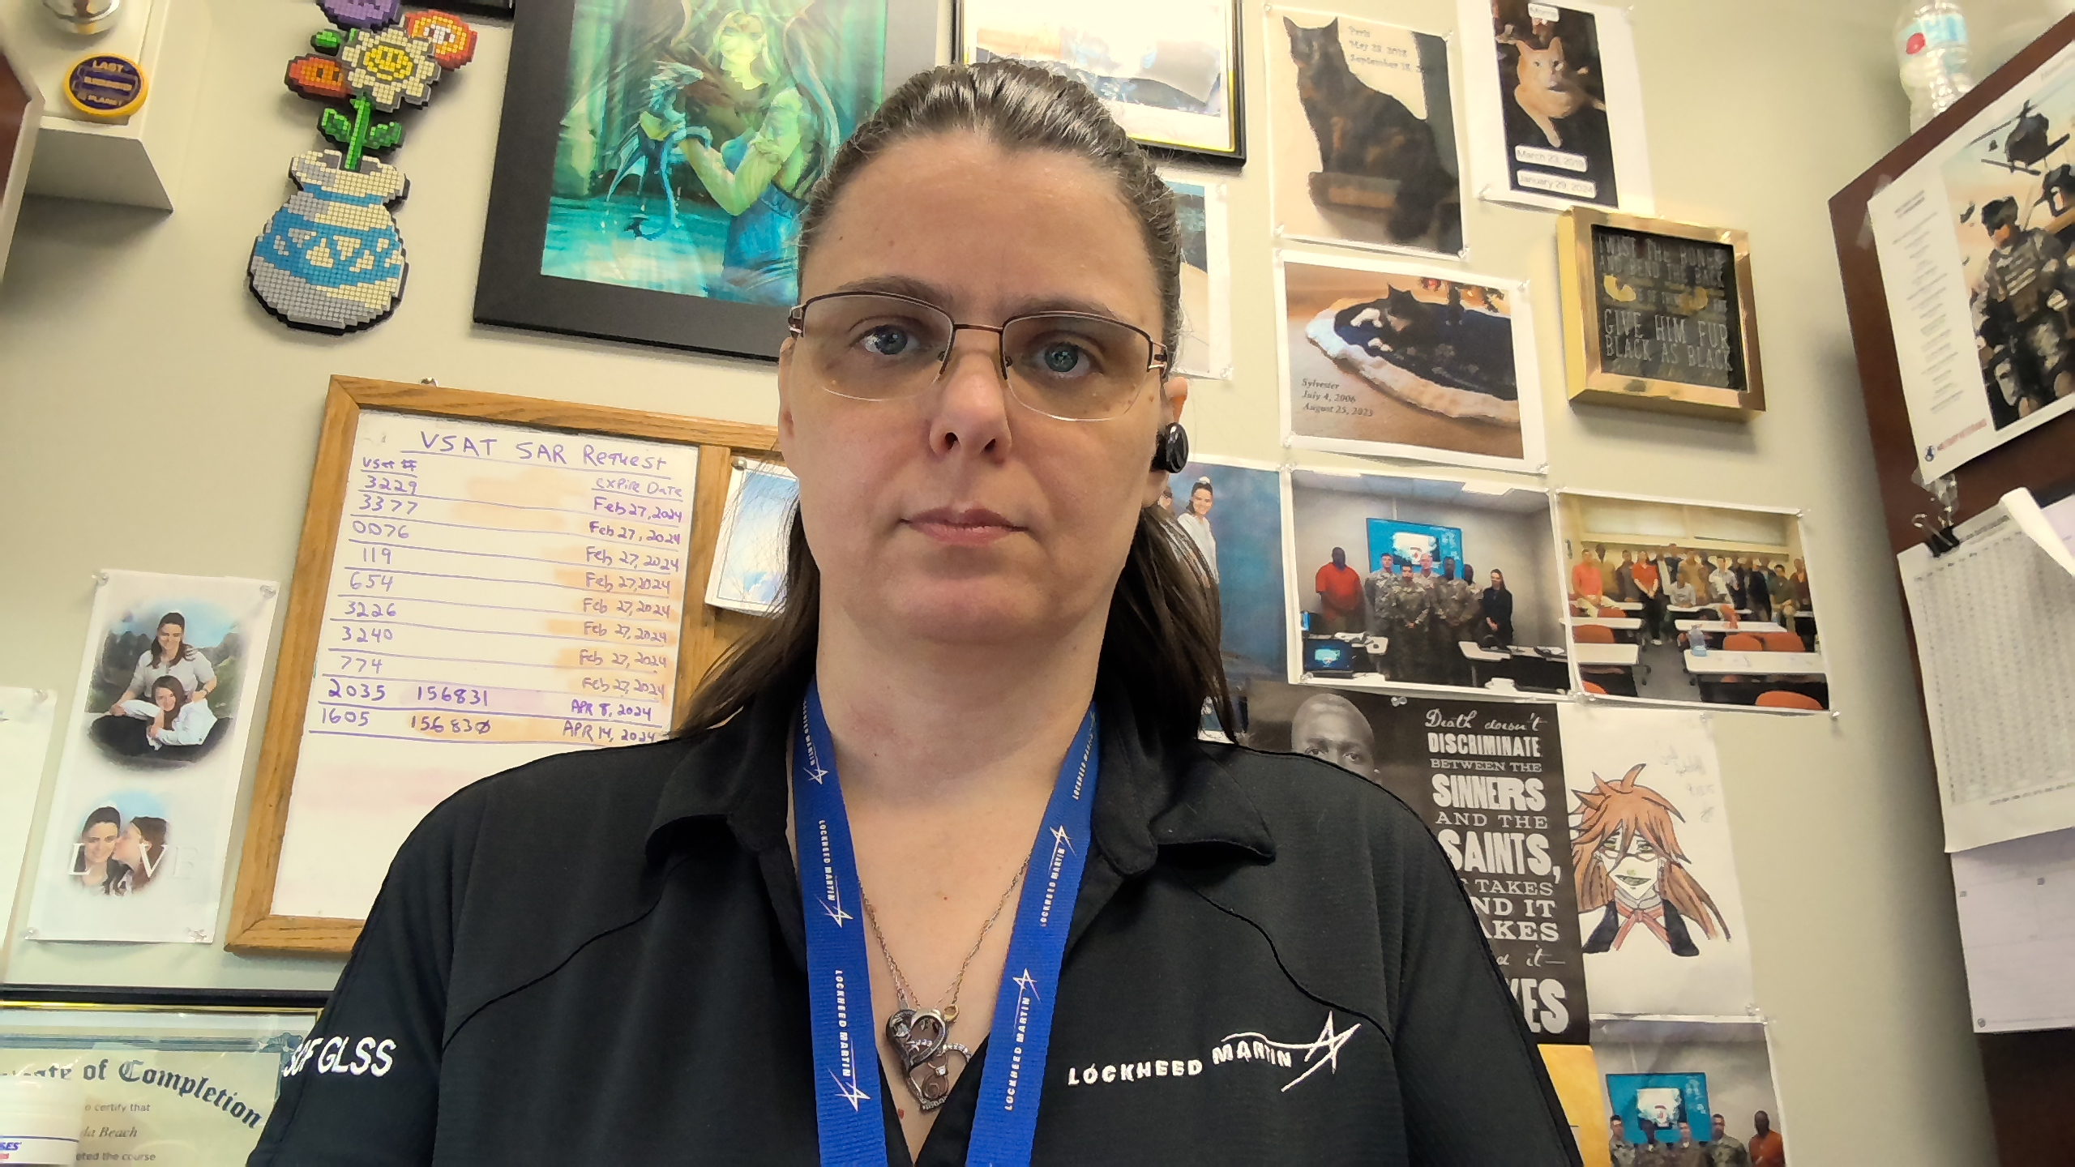


Meet the team
Jonathan Hardwick​​
Brenda Beach
Justin graves​​
Brittany smith

Slide 4
Motto: “These are the Bits You're Looking For!”

Slide 5
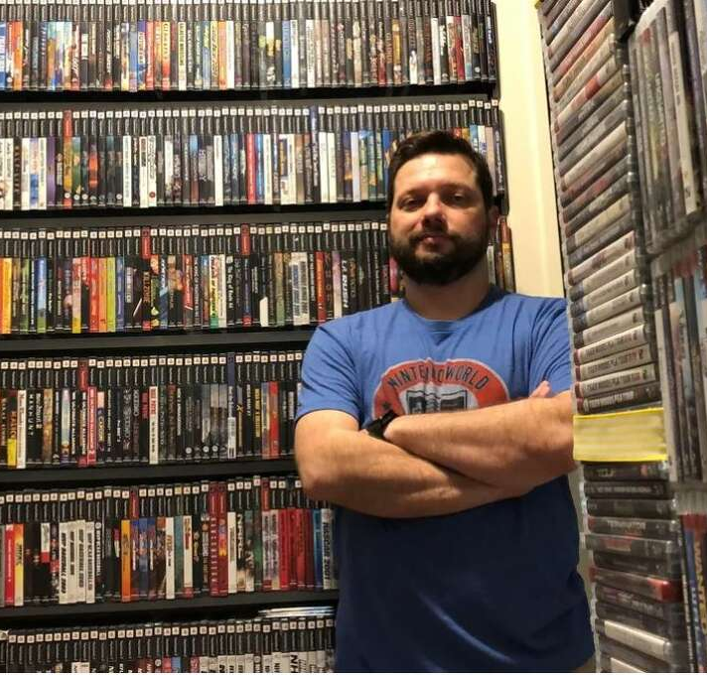
Meet Sam:
Sam has an extensive collection of video games and consoles, and he wants to create a list of his items to determine their potential worth

Slide 6
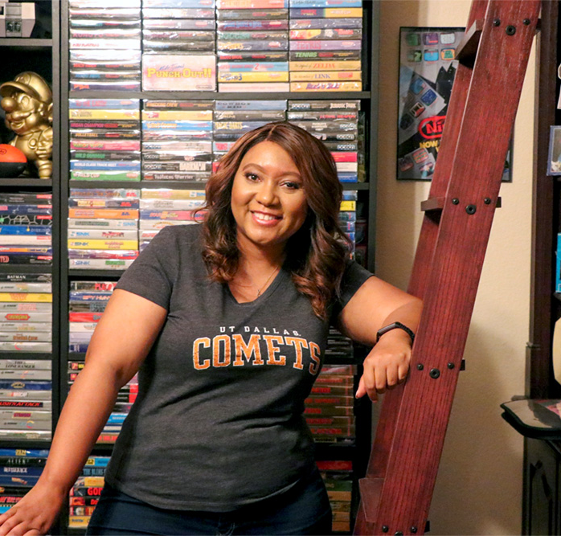
Meet Gwen:
Gwen wants to share the joy of her video game collection by selling them online.

Slide 7
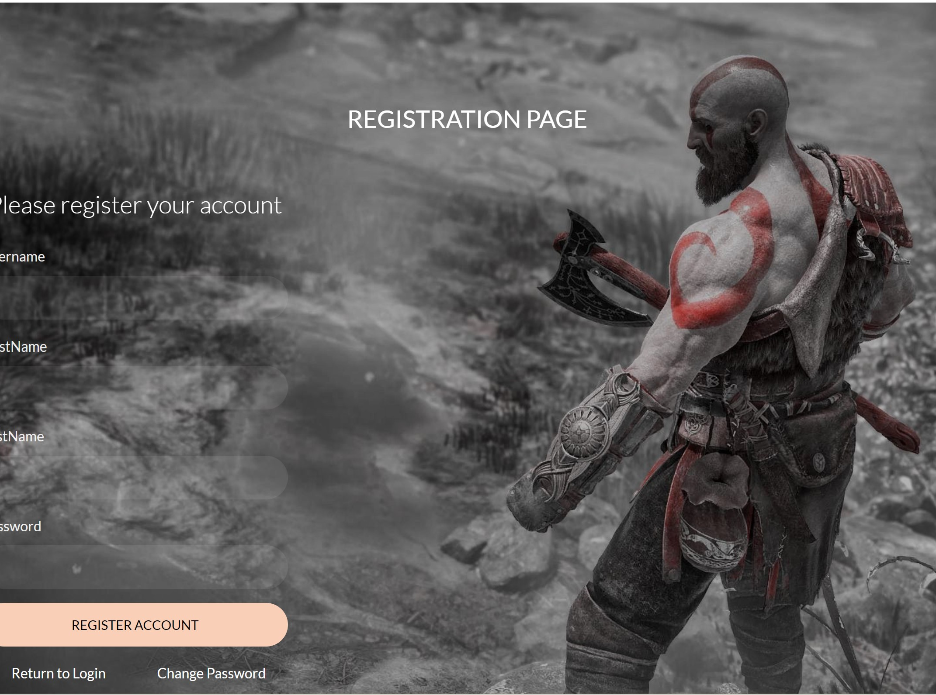
Video Game Library & Sales
User can create an account
Can create a library of all video games, consoles, and peripherals.

Slide 8
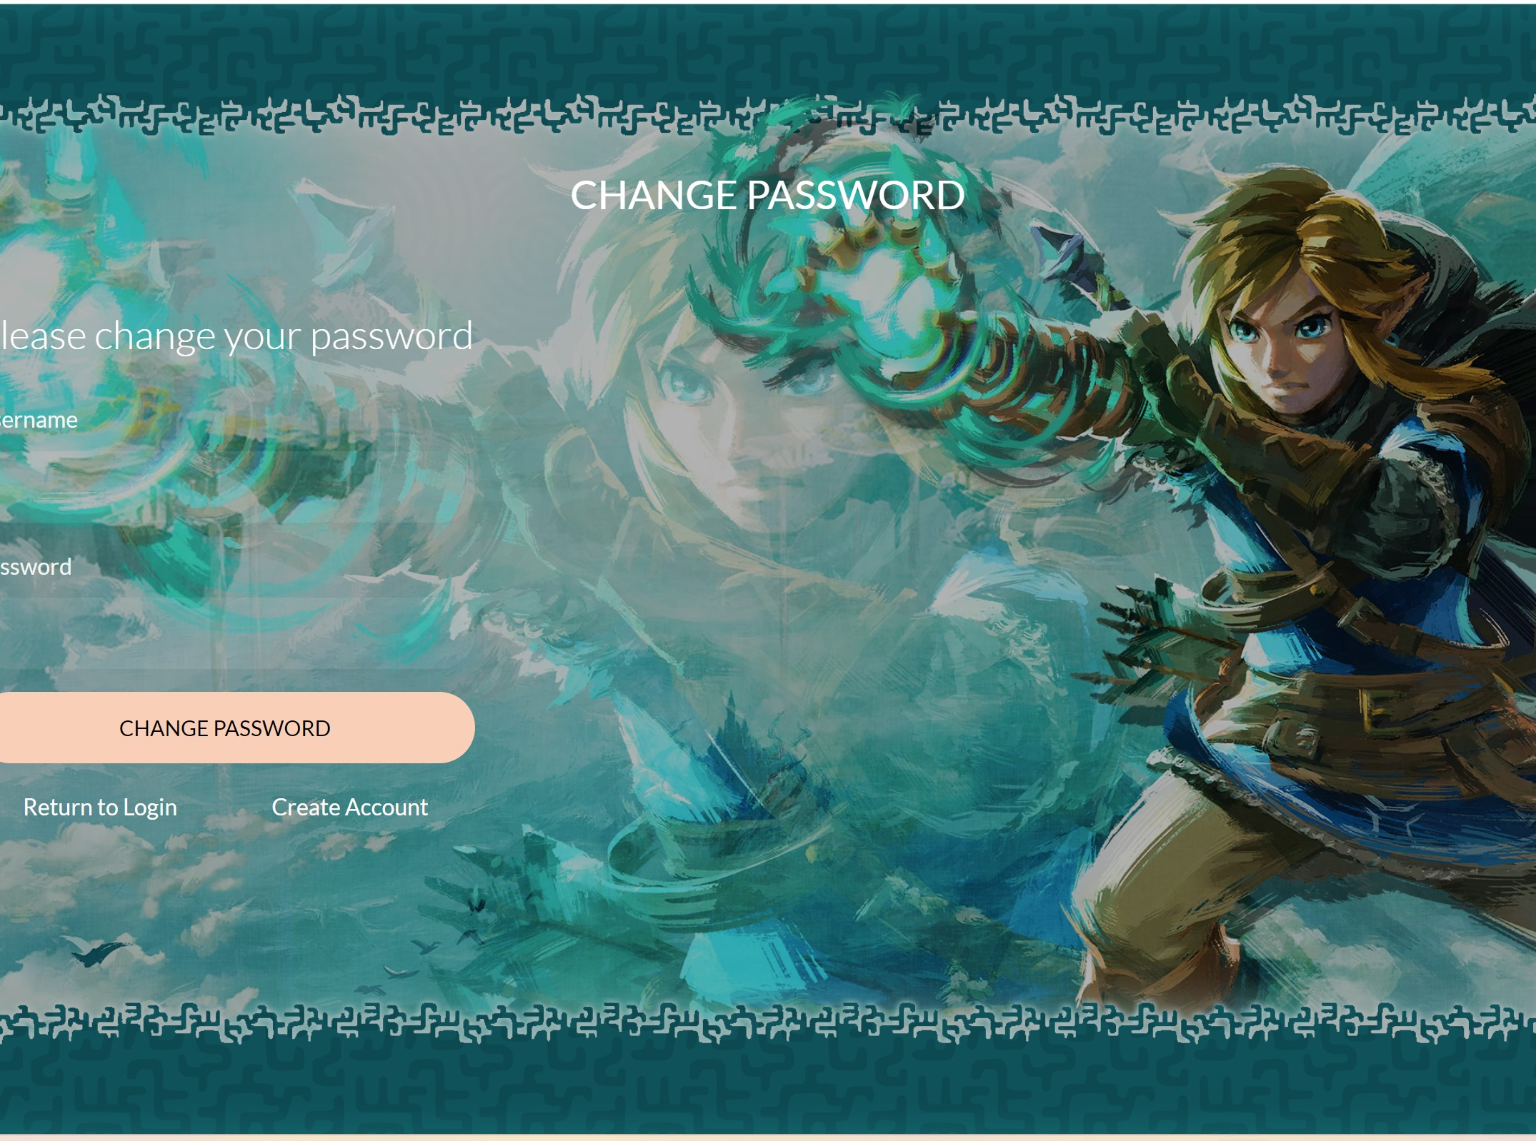
Video Game Library & Sales
If a user forgets his password, he can change it.
A user can also change his username under their account information.

Slide 9
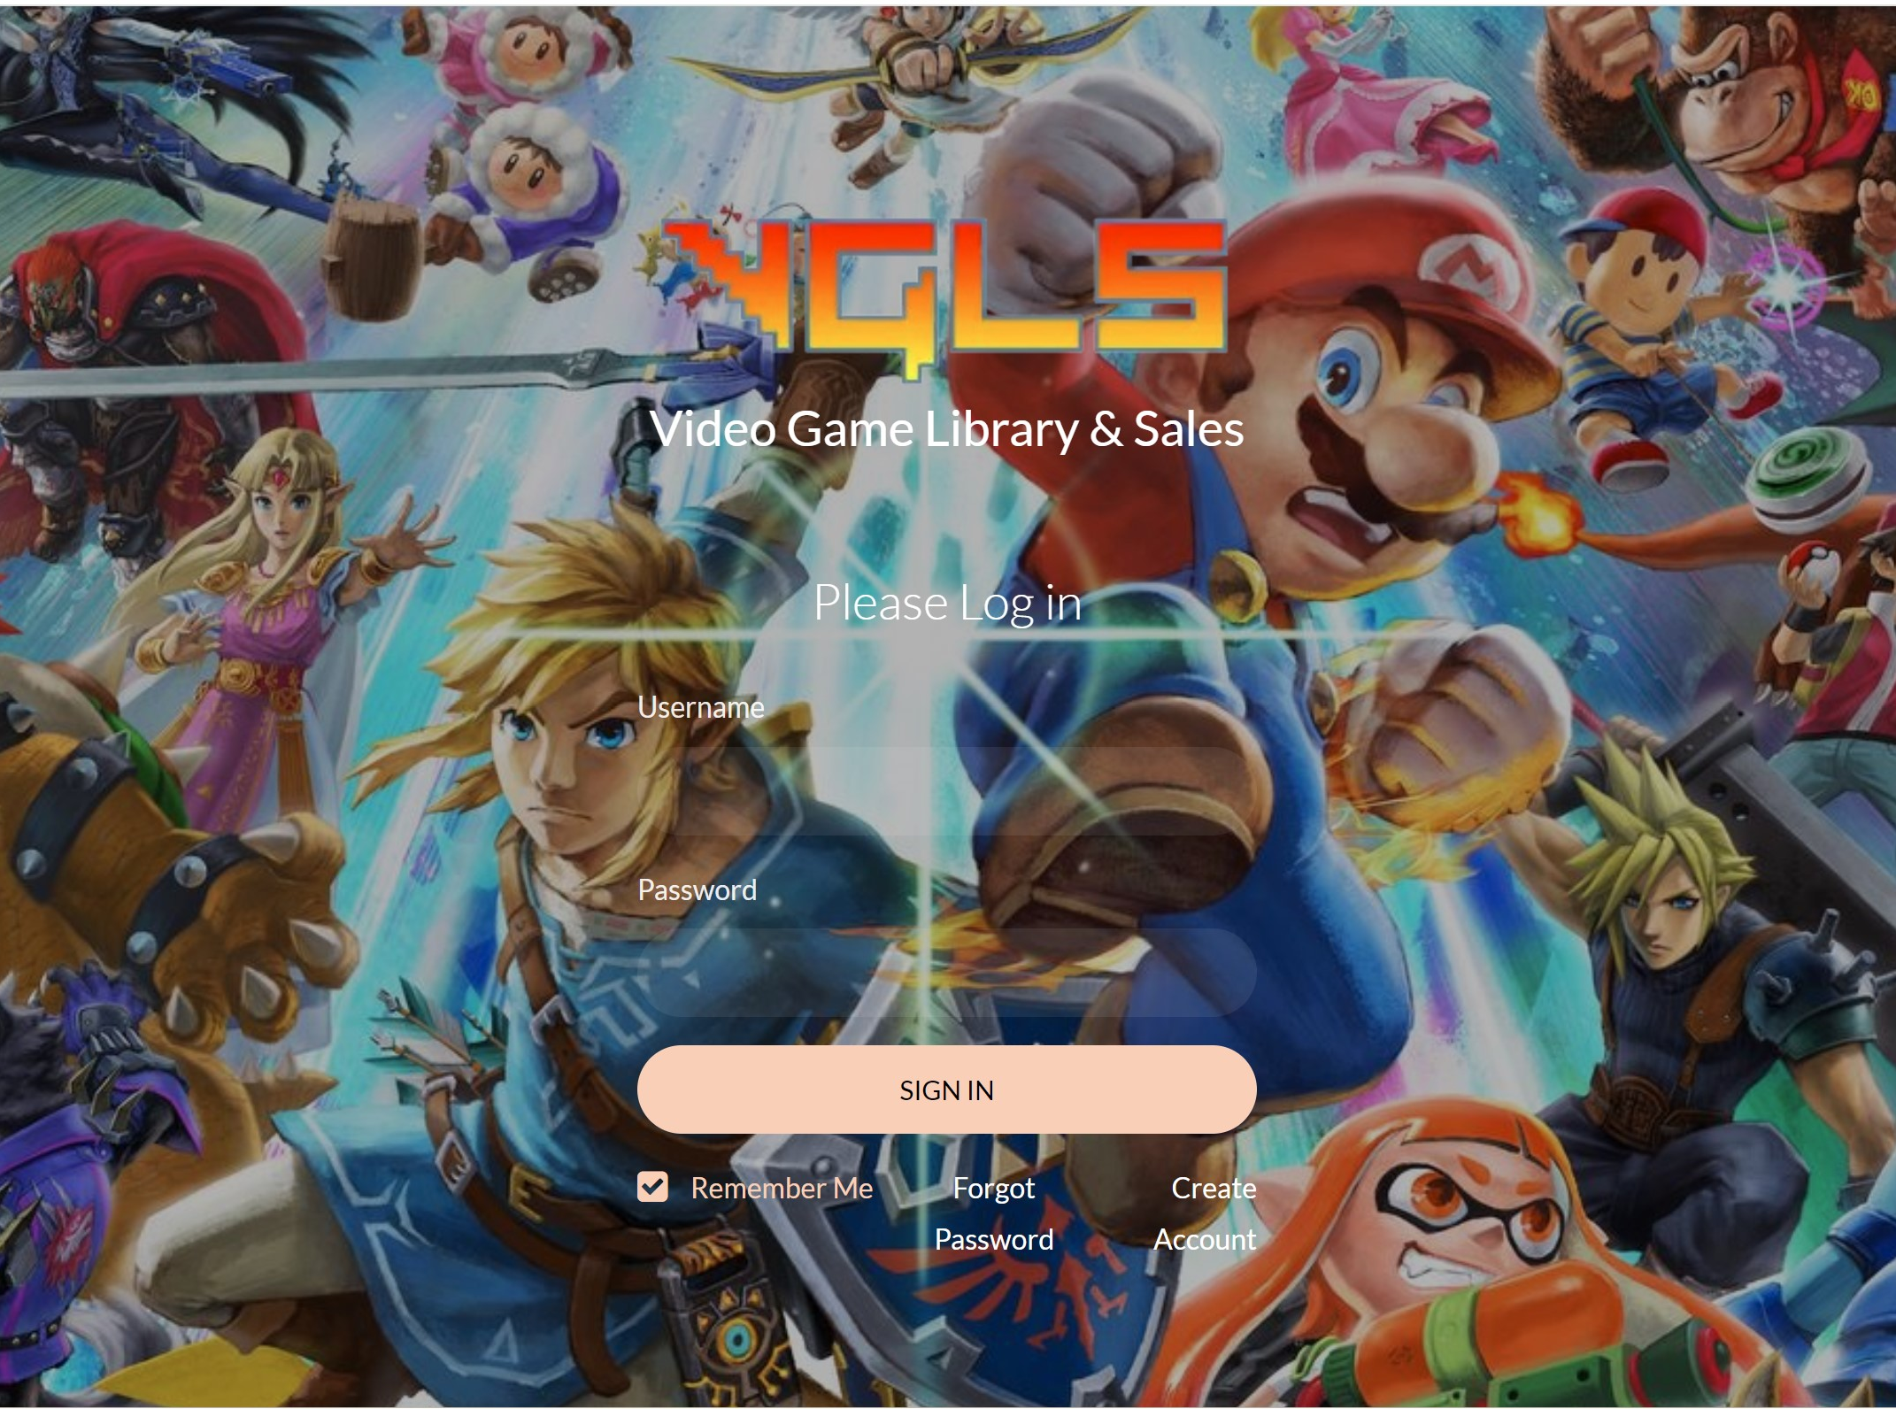
Video Game Library & Sales
The program employees website APIs to determine the current price of the item.
The price will then be displayed in the users inventory.

Slide 10

Video Game Library & Sales
Future Plans
Allow the users to buy and sell items through the website.
Utilize an LLM to create video game recommendations to users.

Slide 11
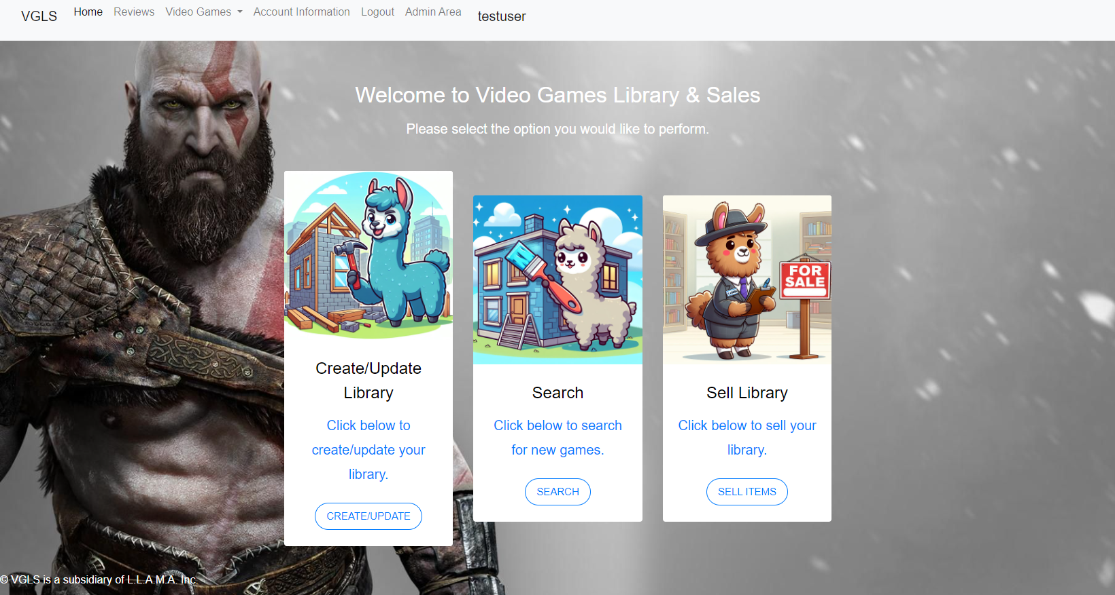
Demo

